Slide 1
Class & Object Diagrams
Unit-III
Part B

Slide 2
Class Diagrams

Slide 3
Topics to be covered
Getting Started
Terms and Concepts
Common Modeling Techniques

Slide 4
Introduction
Class diagrams are the most common diagram found in modeling object- oriented systems.
A class diagram shows a set of classes, interfaces, and collaborations and their relationships.
A class diagram is used to model the static design view of the system.

Slide 5
Introduction
Class diagrams are also the foundation for a couple of related diagrams: component diagrams and deployment diagrams.
Class diagrams are important not only for visualizing, specifying, and documenting structural models, but also for constructing executable systems through forward and reverse engineering.

Slide 6
Getting Started
Building software has much the same characteristics of building a house except that, given the fluidity of software, you have the ability to define your own basic building blocks from scratch.
We use class diagrams to visualize the static aspects of these building blocks and their relationships and to specify their details for construction.

Slide 7
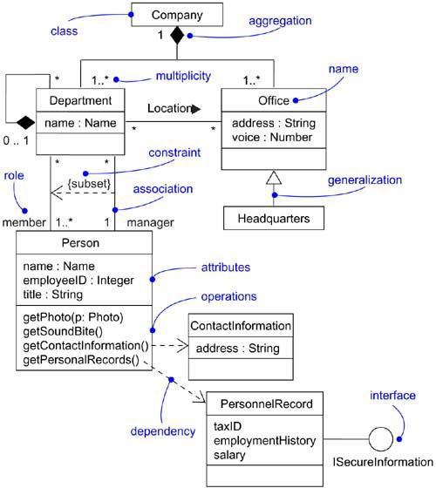
Getting Started

Slide 8
Terms and Concepts
A class diagram is a diagram that shows a set of classes, interfaces, and collaborations and their relationships.
Graphically, a class diagram is a collection of vertices and arcs.

Slide 9
Common Properties
A class diagram is just a special kind of diagram and shares the same common properties as do all other diagrams - a name and graphical content that are a projection into a model.
What distinguishes a class diagram from all other kinds of diagrams is its particular content.

Slide 10
Contents
Class diagrams commonly contains the following things: Classes, Interfaces, Collaborations, Dependency, generalization, and association relationships.
Like all other diagrams, class diagrams may contain notes and constraints.
Class diagrams may also contain packages or subsystems, both of which are used to group elements of your model into larger chunks.

Slide 11
Common Uses
You use class diagrams to model the static design view of a system.
This view primarily supports the functional requirements of a system - it services the system should provide to its end users.
When you model the static design view of a system, you'll typically use class diagrams in one of three ways.

Slide 12
1. To model the vocabulary of a system
Modeling the vocabulary of a system involves making a decision about which abstractions are a part of the system under consideration and which fall outside its boundaries.

Slide 13
2. To model simple collaborations
A collaboration is a society of classes, interfaces, and other elements that work together to provide some cooperative behavior that's bigger than the sum of all the elements.

Slide 14
3. To model a logical database schema
Think of a schema as the blueprint for the conceptual design of a database.
In many domains, you'll want to store persistent information in a relational database or in an object-oriented database.
You can model schemas for these databases using class diagrams.

Slide 15
Common Modeling Techniques
There are three types of modeling techniques for classes.
Modeling Simple Collaborations
Modeling a Logical Database Schema
Forward and Reverse Engineering

Slide 16
Modeling Simple Collaborations
To model a collaboration,
Identify the function or behavior of the part of a system you would like to model.
For each function or mechanism identify the classes, interfaces, collaborations and relationships between them.

Slide 17
Modeling Simple Collaborations
Use scenarios (sequence of activities) to walk through these things. You may find new things or find that existing things are semantically wrong.
Populate the things found in the above steps. For example, take a class and fill its responsibilities. Now, convert these responsibilities into attributes and operations.

Slide 18
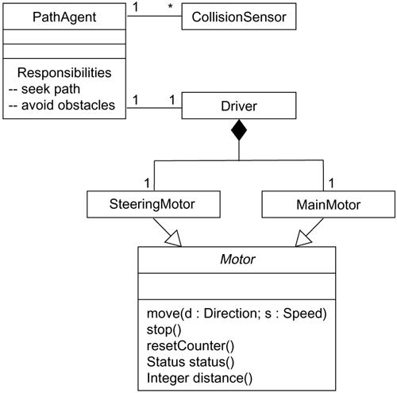
Modeling Simple Collaborations

Slide 19
Modeling a Logical Database Schema
To model a schema,
Identify the classes whose state must be saved over the lifetime of the application.
Create a class diagram and mark these classes as persistent by using tagged values.
Provide the structural details for these classes like the attributes, associations with other classes and the multiplicity.

Slide 20
Modeling a Logical Database Schema
Minimize the common patterns which complicate the physical database design like cyclic associations, one-to-one associations and n-ary associations.
Provide the behavior for these classes by listing out the operations that are important for data access and integrity.
Wherever possible, use tools to convert the logical design to physical design.

Slide 21
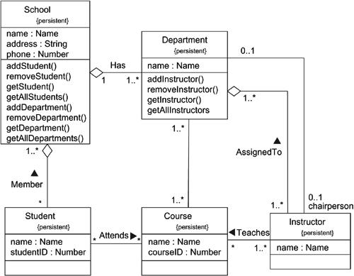
Modeling a Logical Database Schema

Slide 22
Forward Engineering
Forward engineering is the process of transforming a model into code through a mapping to an implementation language.
Forward engineering results in a loss of information, because models written in the UML are semantically richer than any current object-oriented programming language.

Slide 23
Forward Engineering
To forward engineer a class diagram,
Identify the rules for mapping to your implementation language or languages of choice.
Choose your language based on the dependency of the semantics of the language. For example, UML supports multiple inheritance, but some programming languages might not allow this.

Slide 24
Forward Engineering
Use tagged values to specify the target language.
Use tools to convert your models to code.

Slide 25
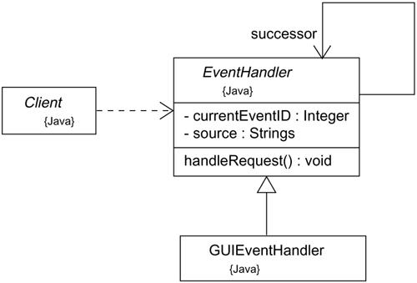
Forward Engineering

Slide 26
Forward Engineering
Forward engineering the class EventHandler yields the following code.
public abstract class EventHandler
{
EventHandler successor;
private int currentEventID;
private String source;
EventHandler()
{
…….
…….
}
public void handleRequest()
{
……
……
}
}

Slide 27
Reverse Engineering
Reverse engineering is the process of transforming code into a model through a mapping from a specific implementation language.
Reverse engineering is incomplete.
There is a loss of information when forward engineering models into code, and so you can't completely recreate a model from code.

Slide 28
Reverse Engineering
To reverse engineer a class diagram,
Identify the rules for mapping from your implementation language or languages of choice.
Using a tool, point to the code you'd like to reverse engineer. Use your tool to generate a new model or modify an existing one that was previously forward engineered.
Using your tool, create a class diagram by querying the model.

