Slide 1
Advanced Behavioral Modeling
UNIT-V

Slide 2
Syllabus
Events and Signals
State machines
Process and Threads
Time and Space
State chart diagrams

Slide 3
Events and Signals

Slide 4
Topics to be covered
Getting Started
Terms and Concepts
Common Modeling Techniques

Slide 5
Introduction
In the real world, things happen.
Not only do things happen, but lots of things may happen at the same time, and at the most unexpected times.
"Things that happen" are called events, and each one represents the specification of a significant occurrence that has a location in time and space.

Slide 6
Introduction
In state machines (sequence of states), we use events to model the occurrence of a stimulus that can trigger an object to move from one state to another state.
Events may include signals, calls, the passage of time or a change in state.
Events may be synchronous or asynchronous, so modeling events is wrapped up in the modeling of processes and threads.

Slide 7
Getting Started
In UML, each thing that happens is modeled as an event.
An event is the specification of a significant occurrence that has a location in time and space.
A signal, passing of time and change in state are asynchronous events.
Calls are generally synchronous events, representing invocation of an operation.

Slide 8
Getting Started
UML allows us to represent events graphically as shown below.
Signals may be represented as stereotyped classes and other events are represented as messages associated with transitions which cause an object to move from one state to another.

Slide 9
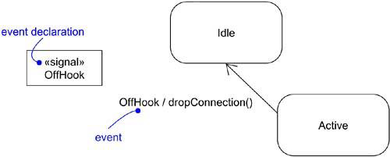
Getting Started

Slide 10
Terms and Concepts
An event is the specification of a significant occurrence that has a location in time and space.
In the context of state machines, an event is an occurrence of a stimulus that can trigger a state transition.
A signal is a kind of event that represents the specification of an asynchronous stimulus communicated between instances.

Slide 11
Kinds of Events
Events may be external or internal.
Events passed between the system and its actors are external events.
For example, in an ATM system, pushing a button or inserting a card are external events.
Internal events are those that are passed among objects living inside the system.
For example, a overflow exception generated by an object is an internal event.
In the UML, we can model four kinds of events: signals, calls, passing of time, and change in state.

Slide 12
Signals
A signal is a named object that is sent asynchronously by one object and then received by another.
Exceptions are the famous examples for signals.
A signal may be sent as the action of a state in a state machine or as a message in an interaction.
The execution of an operation can also send signals.

Slide 13
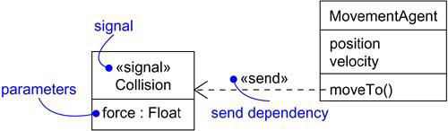
Signals
In UML, we model the relationship between an operation and the events using a dependency stereotyped with “send”, which indicates that an operation sends a particular signal.

Slide 14
Call Events
A call event represents the dispatch of an operation from one object to another.
A call event may trigger a state change in a state machine.
A call event, in general, is synchronous.
This means that the sender object must wait until it gets an acknowledgment from the receiver object which receives the call event.

Slide 15

Call Events
For example, consider the states of a customer in an ATM application:
Above figure shows, modeling a call event is indistinguishable from modeling a signal event.
In both cases, you show the event, along with its parameters, as the trigger for a state transition.

Slide 16
Time and Change Events
A time event represents the passage of time.
In UML, we model the time event using the “after” keyword followed by an expression that evaluates a period of time.
A change event represents an event that represents a change in state or the satisfaction of some condition.
In UML, change event is modeled using the keyword “when” followed by some Boolean expression.

Slide 17
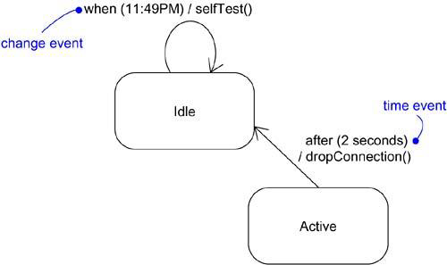
Time and Change Events

Slide 18
Sending and Receiving Events
Any instance of a class can receive a call event or signal.
If this is a synchronous call event, the sender is in locked state with receiver.
If this is a signal, then the sender is free to carry its operations without any concern on the receiver.

Slide 19
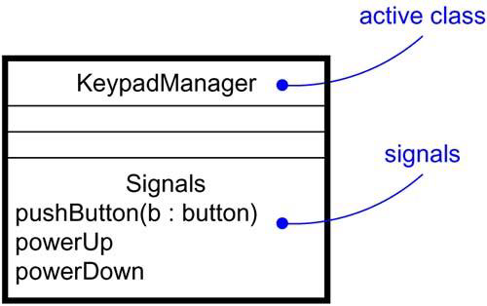
Sending and Receiving Events
In UML, call events are modeled as operations on the class of an object and signals that an object can receive are stored in an extra component in the class as shown below:

Slide 20
Common Modeling Techniques
There are Two modeling technique for Events and Signals
Modeling a Family of Signals
Modeling Exceptions

Slide 21
Modeling a Family of Signals
To model a family of signals,
Consider all the signals to which a set of objects can respond.
Arrange these signals in a hierarchy using generalization-specialization relationship.
Look out for polymorphism in the state machine of the active objects. When polymorphism is found, adjust the hierarchy by introducing intermediate abstract signals.

Slide 22
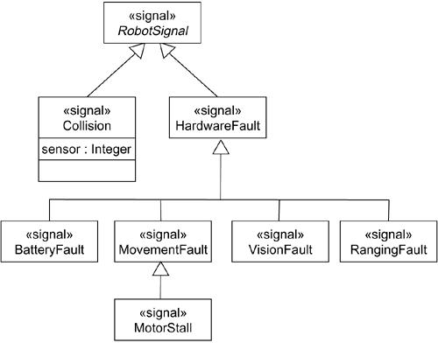
Modeling a Family of Signals

Slide 23
Modeling Exceptions
To model exceptions,
For each class and interface and for each operation of such elements, consider the exceptional conditions that might arise.
Arrange these exceptions in a hierarchy.
For each operation, specify the exceptions that it may rise.

Slide 24
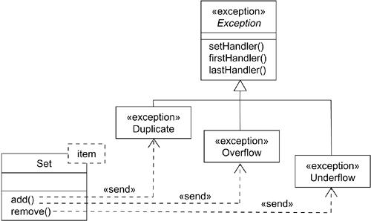
Modeling Exceptions

