Slide 1
Process and Threads

Slide 2
Topics to be covered
Getting Started
Terms and Concepts
Common Modeling Techniques

Slide 3
Introduction
Events may happen and things may take place all at the same time.
When you model a system of the real world, you must take into account its process view, which encompasses the threads and processes that form the system's concurrency and synchronization mechanisms.

Slide 4
Introduction
In the UML, you model each independent flow of control as an active object that represents a process or thread that can initiate control activity.
A process is a heavyweight flow that can execute concurrently with other processes.
A thread is a lightweight flow that can execute concurrently with other threads within the same process.

Slide 5
Getting Started
In the UML, each independent flow of control is modeled as an active object.
An active object is a process or thread that can initiate control activity.
As for every kind of object, an active object is an instance of a class. In this case, an active object is an instance of an active class.
Every kind of object, active objects can communicate with one another by passing messages, here message passing must be extended with certain concurrency semantics, to help you to synchronize the interactions among independent flows.

Slide 6
Getting Started
The UML provides a graphical representation of an active class, as shown in below figure.
Active classes are kinds of classes, it have all the usual compartments for class name, attributes, and operations.
Active classes often receive signals, which you typically enumerate in an extra compartment.

Slide 7
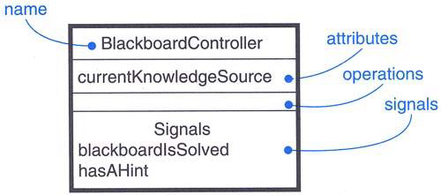
Getting Started
Active Class

Slide 8
Terms and Concepts
An active object is an object that owns a process or thread and can initiate control activity.
An active class is a class whose instances are active objects.
A process is a heavyweight flow that can execute concurrently with other processes.
A thread is a lightweight flow that can execute concurrently with other threads within the same process.
Graphically, an active class is rendered as a rectangle with thick lines.
Processes and threads are rendered as stereotyped active classes.

Slide 9
Flow of Control
In a purely sequential system, there is single flow of control.
This means that one thing, and one thing only, can take place at a time.
When a sequential program starts, control is rooted at the beginning of the program and operations are dispatched one after another.
Even if there are concurrent things happening among the actors outside the system, a sequential program will process only one event at a time, queuing or discarding any concurrent external events.

Slide 10
Flow of Control
In a concurrent system, there is more than one flow of control i.e, more than one thing can take place at a time.
In a concurrent system, there are multiple simultaneous flows of control, each rooted at the head of an independent process or a thread.
If you take a snapshot of a concurrent system while it's running, you'll logically see multiple locations of execution.

Slide 11
Classes and Events
Active classes are just classes with a special property.
An active class represents an independent flow of control, whereas a plain class embodies no such flow.
Plain classes are implicitly called passive because they cannot independently initiate control activity.
You use active classes to model common families of processes or threads.

Slide 12
Classes and Events
An active object is an instance of an active class represents a process or thread.
When an active object is created, the associated flow of control is started; when the active object is destroyed, the associated flow of control is terminated.

Slide 13
Classes and Events
In your diagrams, active objects may appear wherever passive objects appear.
We can model the collaboration of active and passive objects by using interaction diagrams.
An active object may appear as the target of an event in a state machine.
In state machines, both passive and active objects may send and receive signal events and call events.

Slide 14
Standard Elements
All of the UML's extensibility mechanisms apply to active classes.
We use tagged values to extend active class properties, such as specifying the scheduling policy of the active class.
The UML defines two standard stereotypes that apply to active classes.
process | Specifies a heavyweight flow that can execute concurrently with other processes
thread | Specifies a lightweight flow that can execute concurrently with other threads within the same process

Slide 15
Standard Elements
The distinction between a process and a thread arises from the two different ways a flow of control may be managed by the operating system of the node on which the object resides.
A process is heavyweight, which means that it is a thing known to the operating system itself and runs in an independent address space.
A thread is lightweight. It may be known to the operating system itself. More often, it is hidden inside a heavier-weight process and runs inside the address space of the enclosing process.

Slide 16
Communication
When objects collaborate with one another, they interact by passing messages from one to the other.
In a system with both active and passive objects, there are four possible combinations of interaction that you must consider.
First, a message may be passed from one passive object to another.

Slide 17
Communication
Second, a message may be passed from one active object to another.
When this happens, we have interprocess communication, and there are two possible styles of communication.
  First, one active object might synchronously call an operation of another.
  Second, one active object might asynchronously send a signal or call an operation of another object.

Slide 18
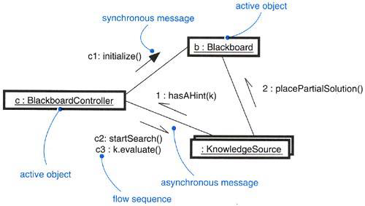
Communication
  A synchronous message is rendered as a full arrow and an asynchronous message is rendered as a half arrow as shown in below figure.

Slide 19
Communication
Third, a message may be passed from an active object to a passive object.
Fourth, a message may be passed from a passive object to an active one.

Slide 20
Synchronization
Synchronization means arranging the flow of controls of objects so that mutual exclusion will be guaranteed.
The key to solving this problem in object-oriented systems is by treating an object as a critical region.
There are three alternatives to this approach, each of which involves attaching certain synchronization properties to the operations defined in a class.

Slide 21
Synchronization
In the UML, you can model all three approaches.
Sequential – Callers must coordinate outside the object so that only one flow is in the object at a time
Guarded – Multiple flow of control is sequentialized with the help of object’s guarded operations. In effect it becomes sequential.
Concurrent – Multiple flow of control is guaranteed by treating each operation as atomic.

Slide 22
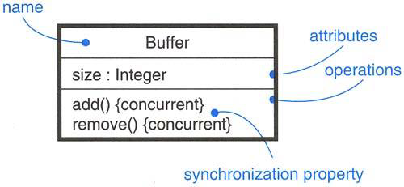
Synchronization
As shown in below figure, synchronization are rendered in the operations of active classes with the help of constraints.

Slide 23
Process Views
The process view of a system encompasses the threads and processes that form the system’s concurrency and synchronization mechanisms.
This view primarily addresses the performance, scalability, and throughput of the system.

Slide 24
Common Modeling Techniques
There are two modeling techniques in Process and Threads
Modeling Multiple Flows of Control
Modeling Interprocess Communication

Slide 25
Modeling Multiple Flows of Control
To model multiple flows of control,
Identify the opportunities for concurrent action and reify each flow as an active class.
Consider a balanced distribution of responsibilities among these active classes, then examine the other active and passive classes with which each collaborates statically.
Capture these static decisions in class diagrams, explicitly highlighting each active class.

Slide 26
Modeling Multiple Flows of Control
Consider how each group of classes collaborates with one another dynamically. Capture those decisions in interaction diagrams.
Apply synchronous and asynchronous messaging, as appropriate.
Apply sequential, guarded, or concurrent operation semantics, as appropriate.

Slide 27
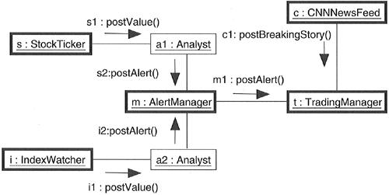
Modeling Multiple Flows of Control

Slide 28
Modeling Interprocess Communication
To model interprocess communication,
Model the multiple flows of control.
Consider which of these active objects represent processes and which represent threads. Distinguish them using the appropriate stereotype.
Model messaging using asynchronous communication; model remote procedure calls using synchronous communication.
Informally specify the underlying mechanism for communication by using notes, or more formally by using collaborations.

Slide 29
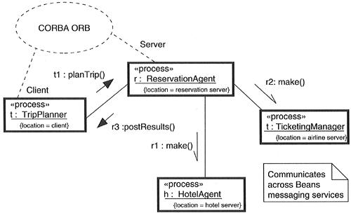
Modeling Interprocess Communication

